Slide 1


Deliverable 1 Team Topic Presentation SEXUALLY TRANSMITTED DISEASES INFORMATION APP
Across Board Champions
Yoshihisa Miyamoto, Changrui Zhang, Anil Gadgotra, Divya Datla, Xueting Chen, Prashanth Subrahmanyam (Presenter)
CS6440: Introduction to Health Informatics
February 17th, 2019
Notes:
Hello Everyone, today we are going to provide you an introduction to our project on Sexually Transmitted Diseases Information App
Our team is called Across Board Champions and we are 6 of us spread across the globe.

Slide 2
Video Link to Presentation
https://youtu.be/hHjjfaleX4U

Slide 3
Agenda
Introduction
Research
Market Context
Needs
Research Methods
Business Case
Problem Description
Target Population
Benefits
Proposed Solutions
Gantt Chart
Conclusion
Notes:
The agenda of this presentation will be to go over the following topics:
The research for this topic:
this consists of Market Context, Needs, Research Methods
Further on we will move to discuss the business case, target population, benefits etc.
Finally, we will show you our timeline to implement this, and some conclusions.

Slide 4
Introduction: Sexually Transmitted Diseases
Amongst the most common infectious disease in USA.
Millions of New infections occur every year.¹
Cause Mild or No symptoms
Possible to have an infection and not know it.
A general term to categorize various diseases such as:
Bacterial Vaginosis, Chlamydia, Gonorrhea, Hepatitis, Herpes etc.
Can affect both men and women.²
Consequences can be more severe for women.
Bacterial, Yeast or Parasitic STDS can be treated with Anti-biotics
No known cure for STDs caused by virus, although disease can be kept in control with medicines.
Notes:
STDs are one of the most common infectious disease in US.

Slide 5
Research
Market Context:
Lots of information & assessments available online on STDs
Problem is this information is scattered and disorganized
More than 20 kinds of STDs, with multiple complexties such as pregnancy
The onus of finding and digging through information is on the patient
Needs:
A one-stop shop dedicated for STDs:
Initial self-diagnostics based on patient reporting their symptoms and profile.
Appointment scheduling
Reminders on lifestyle and medicines
Research method
Online research of current available web and mobile applications
Research existing surveys and research to identify current issues

Slide 6
Business Case
Problem:
STDs Affect an estimated 20 million men and women in US each year.
Treatment cost of STDs is in excess of $14 billion in US each year.
Wide Variety: More than 20 STDs have been identified
For whom?
Predominantly Youth Ages 15-24:
Account for half of the 20 million new STDs that occur each year.
The U.S. pregnancy rate among youth aged 12–19 years is one of the highest in the developed world.
46% of high school students in 2009 had ever had sex¹.
Can be used by other age groups as well.

Slide 7
Discussion on Target Population
Proportion of recreational computer time 8–18 years of age spend in various activities.
Source:
Kachur, R., Mesnick, J., Liddon, N., Kapsimalis, C., Habel, M., David-Ferdon, C., Brown, K., Gloppen, K., Tevendale, H., Gelaude, D.J., Romero, L., Seitz, H., Heldman, A. B., Schindelar, J. (2013). Adolescents, Technology and Reducing Risk for HIV, STDs and Pregnancy. Atlanta, GA: Centers for Disease Control and Prevention.
Who’s online? The internet by age groups.
Teens searching for general health information online.
% of online teens on social network sites.

Slide 8
Business Case
Benefits to End User
Easy availability of resources and education for the public.
Online interface, giving personalized anonymous guidance to users.
Improved time to patient diagnosis and treatment of STDs
Drive behavioral change in responsible attitude towards STDs.
Solutions
Daily notification regarding information about different STDs as well as ways to prevent that
Interactive self-diagnose tool and suggested treatment plans
Doctor appointment system
Testing recommendation

Slide 9
Data Sources for Solution
Daily news | https://www.cdc.gov/std/news.htm
Diagnose | https://www.cdc.gov/std/general/default.htm https://www.health.state.mn.us/diseases/index.html https://www.calculators.org/health/std-risk.php http://www.sfcityclinic.org/stdbasics/stdchart.asp https://www.stdcheck.com/std-test-recommender.php http://erepository.uonbi.ac.ke/bitstream/handle/11295/30038/Main%20article.pdf?sequence=1 https://www.hl7.org/fhir/practitioner.html
Treatment | https://www.cdc.gov/std/tg2015/2015-wall-chart.pdf
Testing/ Doctor recommendation | https://www.cdc.gov/std/prevention/screeningreccs.htm https://gettested.cdc.gov/search_results
Related apps | https://www.stdcheck.com/ https://www.stdlabs.com/

Slide 10
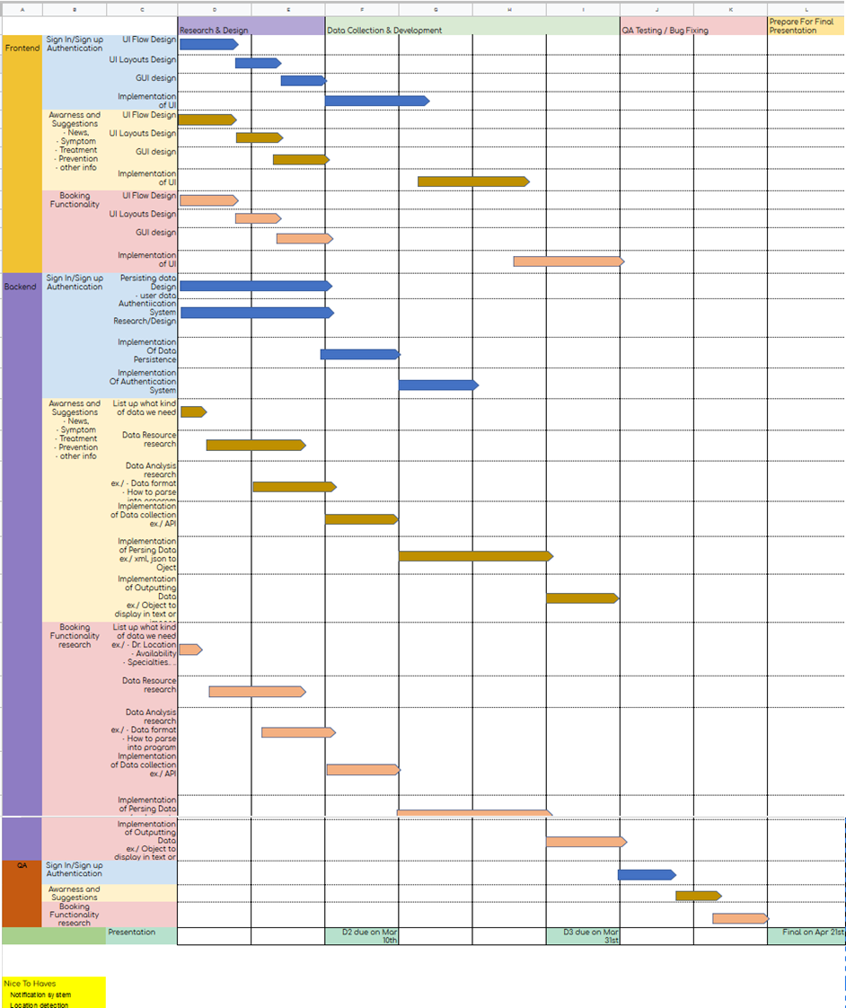
Gantt Chart

Slide 11
Conclusion
Although health information readily available, information on STDs not available in a personalized way, based on individuals
Adolescents rely on cellphones and internet for many of their activities, including health information
A solution to be developed that allows users to:
Get information on STDs in a centralized place
Book appointments based on STD with a doctor specializing in that issue.

